Slide 1
VR and Voice User Interface
5CS020-HCI (Human Computer Interaction)
Week - 7
April, 2024

Slide 2
Virtual Reality
Content Outline
Not a new concept
Definition
Implementation (Past and Present)

Slide 3
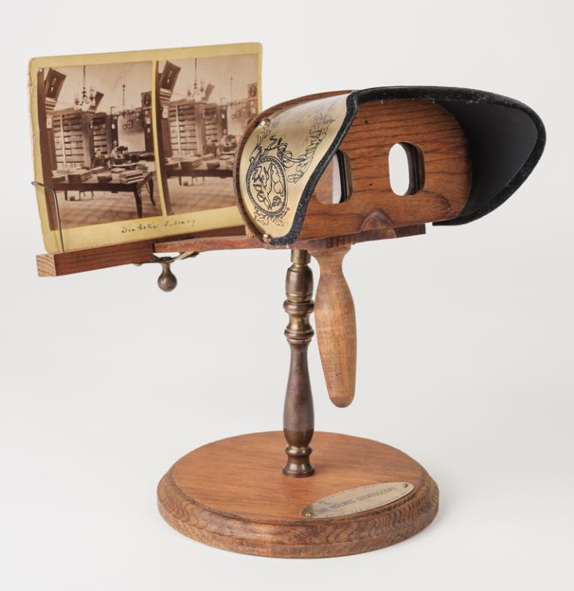
Stereoscopic images (1838)
Research shows brain processes different (2D) images (from each eye) into a single 3D image/object
Viewing 2 side-by-side images (via a ‘Stereoscope’) gives the user a sense of depth and immersion
The same principles are still used today for low-budget VR
https://www.sutori.com/item/untitled-1599-4117

Slide 4
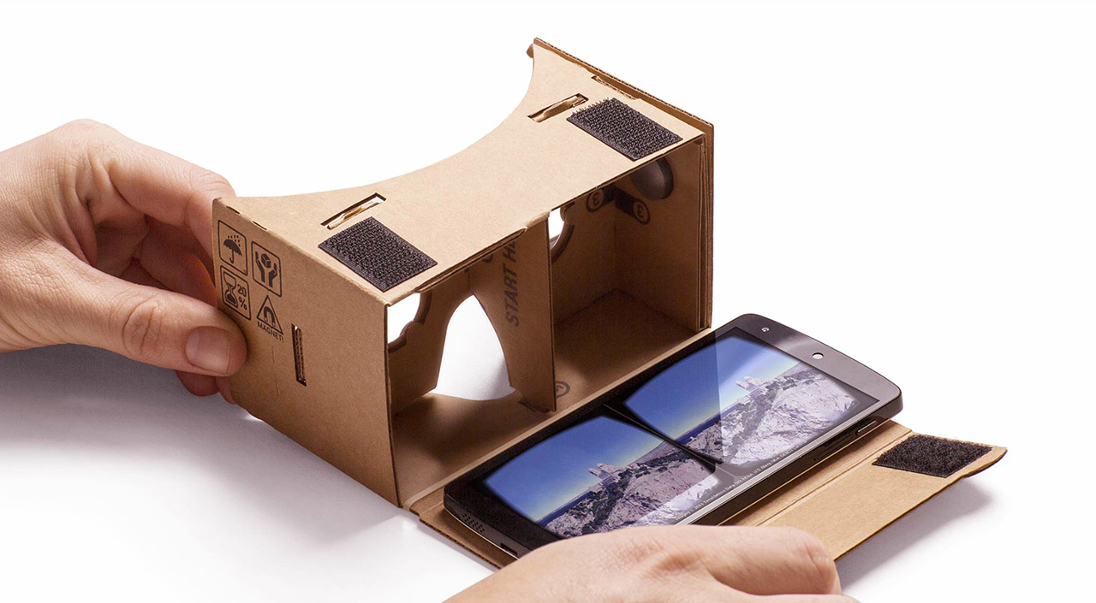

Slide 5
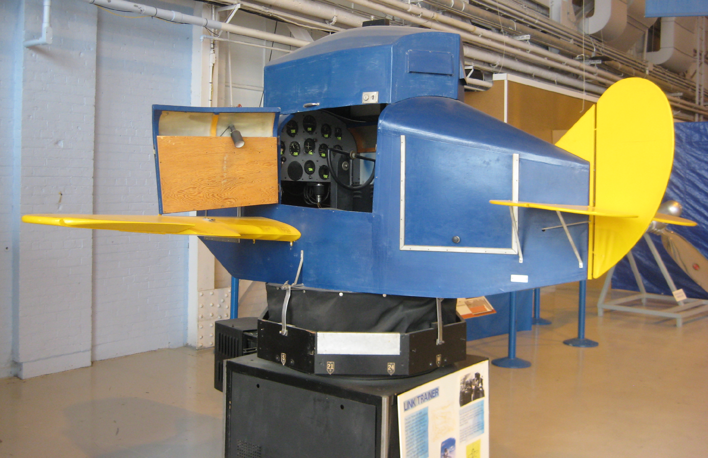
Link Trainer (1930s - 1950s)
Invented by Edward Link in 1929
Link trailer was a flight simulator
It simulated flight through a series of bellows and pulleys
Primarily used for training pilots and aviation safety during World War II and the post-war era.

Slide 6
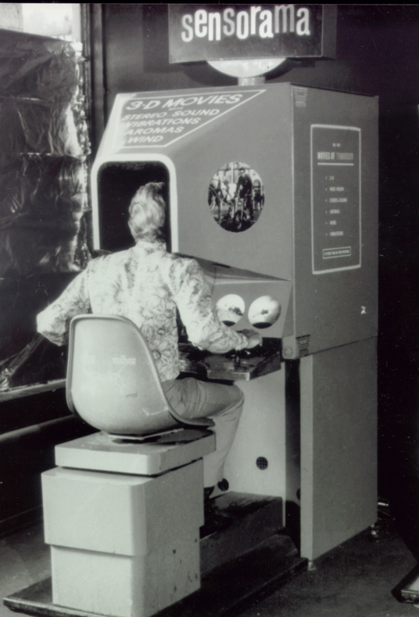
Sensorama - 1950s
Allowed viewers to take ‘virtual’ bike ride through Brooklyn, New York
Complete body tilting
Stereo sound, wind effects
‘Aromas’ triggered at key points during the ‘ride’

Slide 7
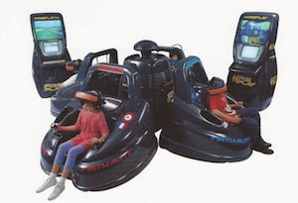
1990’s VR
Virtual Group arcade machines
Niche market due to size and cost

Slide 8
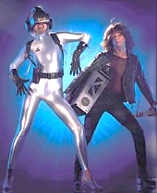
1990’s VR
Virtual Group arcade machines
Niche market due to size and cost
Silver spandex catsuits

Slide 9
I've seen things you people wouldn't believe... Attack ships on fire off the shoulder of Orion... I watched C-beams glitter in the dark near the Tannhäuser Gate. All those moments will be lost in time, like tears in rain... Time to die
Can you guess which movie this is from?

Slide 10


Pop culture references
1968
1982

Slide 11

Why use VR?
History repeats itself - VR is back in fashion
Why?
Newer cheaper tech + Gamers as early adopters
Non-Game VR
Virtual tours
Mechanical Engineering

Slide 12

What is VR?
A (3D) virtual environment that convinces you that you are someplace else
VR does this through
Presence: Sensation of being there in the virtual world
Immersion: Aids presence through ‘simulating’ our senses
https://unsplash.com/photos/EOSHmMbjT8g

Slide 13
Immersion is created through
Motion
Stereoscopic Images
Sound

Slide 14
Motion
Motion is created by simulating the visual cortex (part of the brain that perceives motion)
VR headsets do this by tracking the head movement or position tracking
i.e. the objects stay stationary while the user’s head moves
If head movement and virtual movement doesn’t match, it causes motion sickness

Slide 15
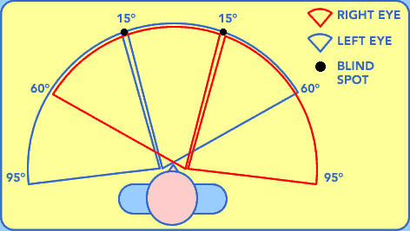
Stereoscopic images
2 images, side by side, slightly offset to create an illusion of depth
This concerns our field of view - width of the viewing area
The wider the view, more natural
Human vision ~ 180 degrees
Oculus Rift ~ 100 degrees
Google cardboard ~ 90 degrees
Standard cinema screen ~ 54 degrees

Slide 16
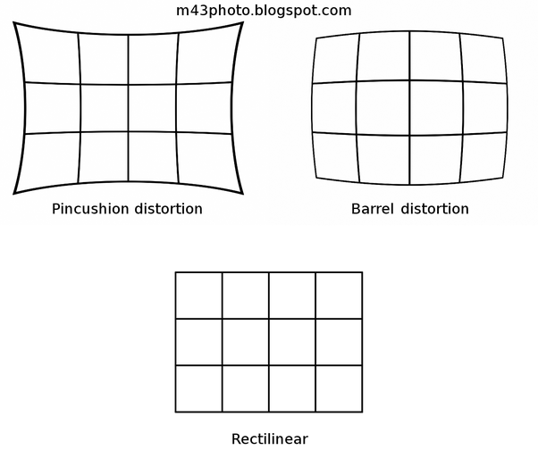
Implementation hurdles
For headsets to have wide FOV, they require wide angle lenses
Unfortunately, lenses distort stereoscopic images (pincushion effect)

Slide 17
Solution
The solution is to barrel distort the images so that it looks correct through the lenses

Slide 18
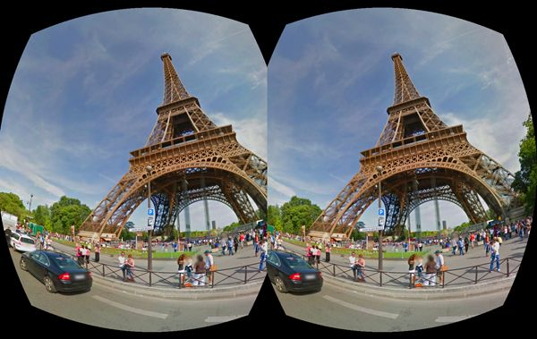

Slide 19
Sound
Sound adds to the ‘storytelling experience’
Things to be mindful of
Use binaural sound
Apply doppler effect
Use ‘sound cues’ as part of storytelling or to ‘set the mood’

Slide 20
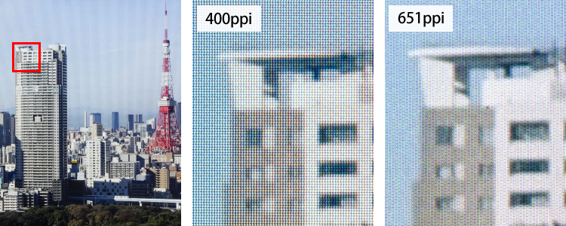
VR UX best practices
VR needs to be of high resolution - low resolution leads to ‘screen door’ effect

Slide 21
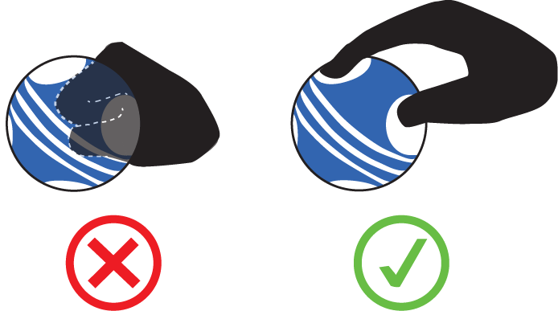
VR UX best practices
Headsets should have some form of Inertial Measurement Unit i.e. accelerometer and/or gyroscope
Current advice, VR experience should be less than 20 minutes at one go
Affordances
https://blog.leapmotion.com/interaction-sprint-exploring-the-hand-object-boundary/visual-affordance-vr/

Slide 22
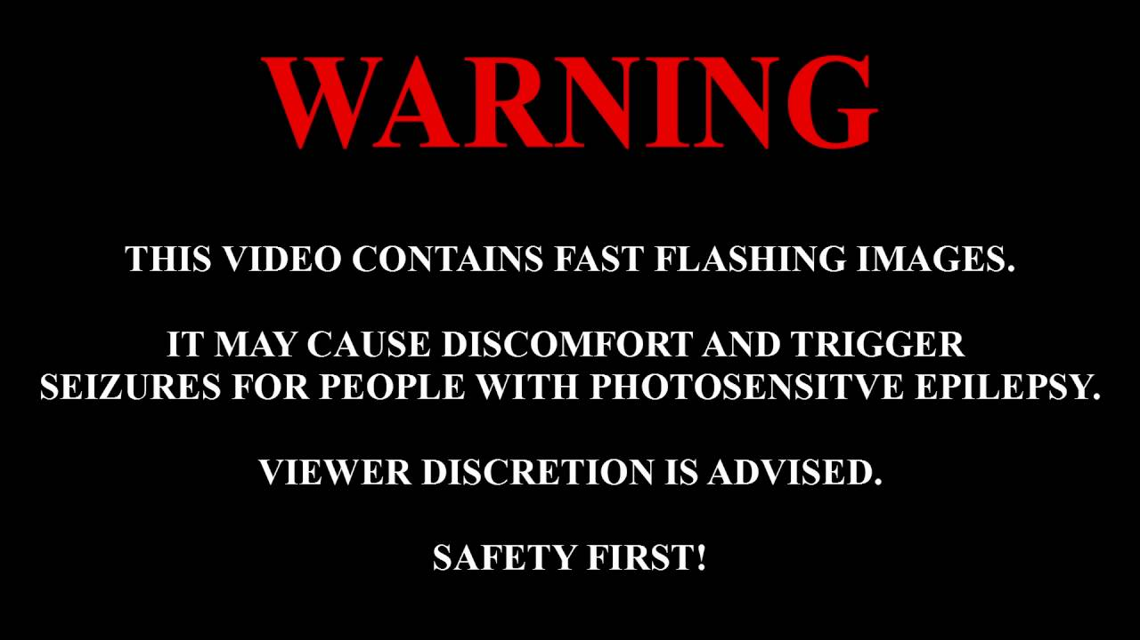
VR accessibility
Take body limitations into consideration
Hearing loss can affect the use of sound cues
Photosensitive epilepsy (Flashing lights, contrasting patterns)
Lens Quality/ Focus adjustment for myopic/ mytopic eyes
Inter pupillary distance

Slide 23
So what is VR?
VR is technically a creation of immersion/ presence through
Simulating motion
Stereoscopic images
Sound
Head wears

Slide 24
Voice User Interfaces (VUI)
Content Outline
History
Advantages/ Disadvantages
Designing for VUI

Slide 25
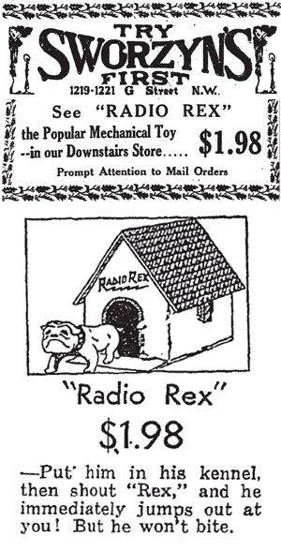
Also not a new concept
1920s - ‘Radio Rex’ first voice activated toy
1950s - Automatic Digit Recognizer
Could recognize spoken numbers (0-9)
Was 6 feet high and filled an entire lab
1960s - IBM Shoebox
Could perform simple maths (via voice command)
16 word vocabulary

Slide 26
Further development
1980s - IBM Speech recognition system with 20,000 word vocabulary
Vocabulary was still limited
Words… had… to… be… spoken… slowly
1990s - Dragon NaturallySpeaking (Dictation Software)
2000s - Voice/ Speech technology became more mainstream (telephone call centers)
2005/ 2006 - Siri
Originally developed by Stanford Research Institute (SRI)
Purchased by apple and integrated into iPhone 4S onwards
2007/9 - Voice control in microsoft windows vista/ 7
2014 - Amazon introduces Alexa
2016 - Google Assistant

Slide 27
Why design for voice
A perfect compliment for touchscreens and non-touchscreen devices
Is efficient
We can deliver/ process audio quicker than visual/ physical I/O
Is accessible
Suitable for wide age groups
Suitable for wide abilities
More natural
Compared to touch screens or keyboard and mouse

Slide 28
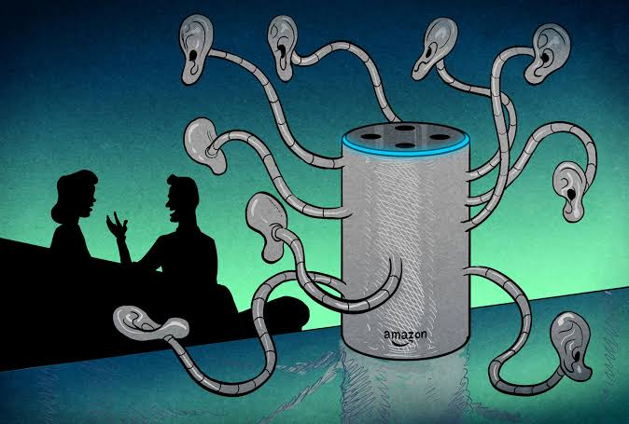
Disadvantages
Talking to computers is still not natural
Limited support for regional accent/ slang
Privacy concerns
“OK google, read my emails”
Alexa conversations sent to Amazon servers to ‘improve’ voice recognition/ personalize search
https://criminallawstudiesnluj.wordpress.com/2021/09/18/alexa-a-catalyst-in-the-evidence-law/

Slide 29
Traditional principles in VUI
Confirmation/ Feedback
Reduce Cognitive Overload
Error Handling
HCI/ UX/ Schneiderman’s rules are still valid

Slide 30
Confirmation
As per rule 4: Design dialog to yield closure, providing ‘task confirmation’ is considered best practice
Confirmation reassures us that a conversation has been understood by both parties

Slide 31
Example
Scenario
Computer, turn off the bathroom lights
Probably worked, but without actually physically checking, always a nagging doubt…
Considered best practice to offer confirmation on task completion
Best practice
User: “Computer, turn off the Bathroom Lights”
Computer: “OK, the bathroom lights are now switched off”

Slide 32
Visual Feedback
Despite the audio nature, it is still possible to show a degree of visual feedback
Eg: to indicate that the system is listening to, or processing a request

Slide 33
Reduce cognitive overload
Humans store audio in ‘short-term’ memory (so easy to overload with too many requests)
Amazon suggest no more than three options/choices during interaction

Slide 34
Error Handling in VUI
Traditional error handling = Display Messages
The expectation is that the user will correct things
In VUI, the error handling should reflect the way we handle conversations

Slide 35
Error Handling in conversations
Incomplete sentence:
“मैले दराज बाट सामान मगाको है…”
How we handle it in conversations:
Guess: “...खत्तम पर्यो हो?”
Prompt: “...अनि?”
Rephrase the sentence: “अँ त, सामान मगाइस् दराज बाट। अनि के भयो?”

Slide 36
Other error handling VUI approaches
Re-prompts
VUI: “I’m sorry, I did not hear that”
VUI: “Sorry, what was that again?”
Say Nothing
In error event, the VUI stays silent, relies on the human tendency to repeat, if not heard the first time
Error Escalation
Notes:
a rapid increase; a rise

Slide 37
Error Escalation
Escalate initial error from general to specific
VUI: “What is your date of birth?”
User: “uh…”
VUI: “Please say your date of birth as 6 numbers, for example, if birthdate is 11th January 1991, say 11, 01, 1991”

Slide 38
Some additional VUI design principles
Personality (Humor, Delivery, Empathy)
Context
Ambiguity/ Disambiguation

Slide 39
Personality
Ideally, a VUI should have ‘personality’ as this is appreciated by humans
Personality is subjective
Personality can be considered as a combination of Humor, Delivery, and Empathy

Slide 40
Context
Context is important as humans intuitively place conversations in context without explicitly stating it
Use of context allows VUI to give the impression of ‘intelligent’ and ‘natural’ conversation
Example:
“Our leader is an idiot”

Slide 41
Context
Which leader?
Conversation between Nepalese? (Sher Bahadur Deuba)
Conversation between Indians? (Modi)
Conversation between Russians? (Putin)

Slide 42
Ambiguity/ Disambiguation
Human requests/ statements can be ambiguous
VUI may need to seek clarification (as part of error handling/ re-prompting) in order to provide the requested information
Example:
“चक्रपथ जाने बाटो कता?”

Slide 43
Conclusion
Talking computers are not new
Advantages: Efficient, Accessible, Natural
Disadvantages: Accents, Privacy
Designing for voice
Traditional (Confirmation, Reduce Cognitive Overload, Error Handling)
New (Personality, Context, Ambiguity)
Notes:
https://www.uxpin.com/studio/blog/voice-user-interface/

